Slide 1

Session 10
Black Box Testing (4)
Cause Effect Graph
chengbaolei@suda.edu.cn

Slide 2

Black Box Testing Techniques
• Boundary Value Analysis
• Equivalence Partitioning
• Decision Table
• Cause-Effect Graph
• Combinatorial Test

Slide 3

Cause-Effect Graph
The Cause-Effect Graphing technique is a black-box testing technique and requirement-based technique.
Cause-Effect Graphing is very similar to Decision Table-Based Testing, where logical combinations of the inputs produce outputs; this is shown in the form of a graph.
The Cause-Effect Graphing technique begins with the set of requirements, and determines the minimum number of test cases to completely cover the requirements.

Slide 4

Cause-Effect Graph
Cause-effect graph models the logical relationship
between program input and output which can be expressed as a Boolean expression.
Cause:any condition in the requirements that may
effect the program output
(e.g. side>0,side1!=side2,month=feb)
Effect:response of a program to some combinations
of input conditions
(e.g.error message displayed on the screen,
a new window is displayed,or
database is updated)

Slide 5
Cause-Effect Graph
Causes /effects are represented as nodes in the cause-effect graph
The graph also includes a number of intermediate nodes linking causes and effects

Slide 6
Procedure
Identify causes and effects in specification
Make Boolean graph linking causes and effects.
Annotate impossible combinations of causes and effects (adding constraints)
Develop decision table from graph
Transform each column into test case

Slide 7
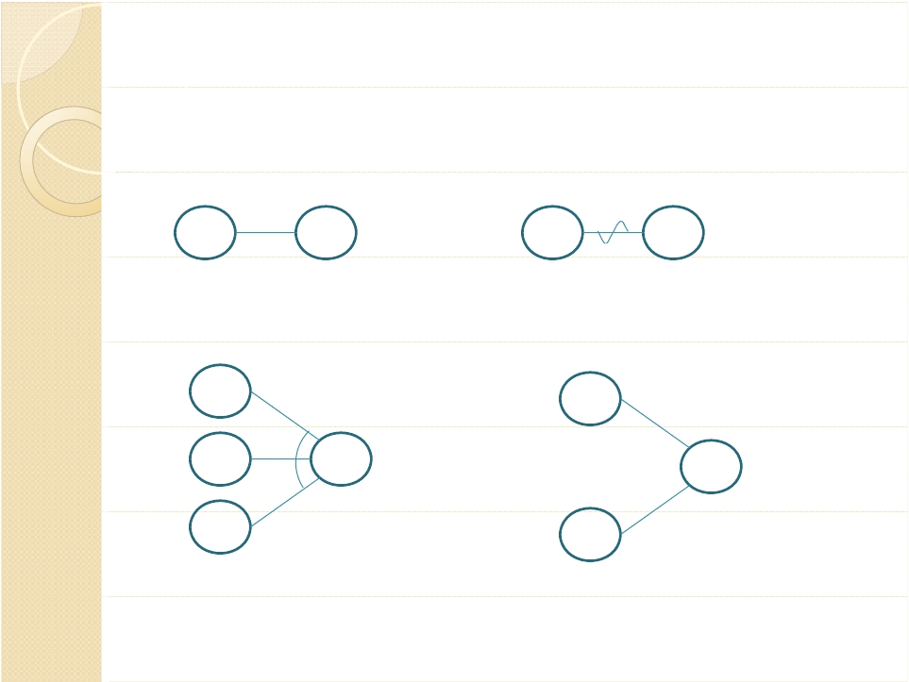
Notations used in cause-effect graphs
Identify causes and effects in specification
Make Boolean graph linking causes and effects
C
E
C
E
if C, then E
C1
if ~C, then E
C1
^
C2
E
V
E
C3
if C1 and C2 and C3, then E
C2
if C1 or C2, then E

Slide 8

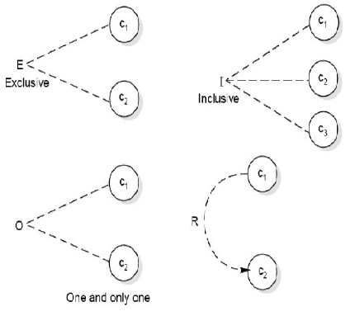
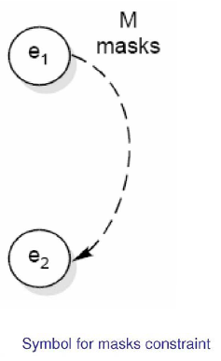
3. Annotate impossible combinations of causes and effects (adding constraints)

Slide 9
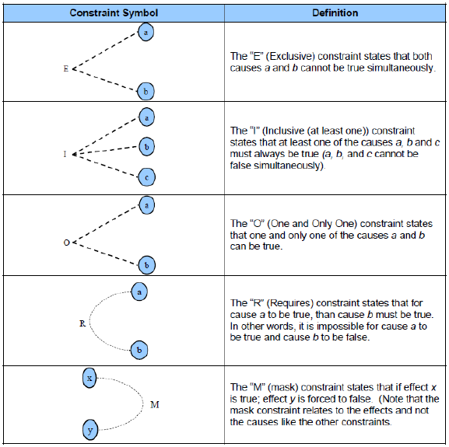

Slide 10
Example1
Passenger may get a discount ticket if
he/she is below 12 or a student below 25.

Slide 11
Procedure
Identify causes and effects in specification
Make Boolean graph linking causes and effects.
Annotate impossible combinations of causes and effects (adding constraints)
Develop decision table from graph
Transform each column into test case

Slide 12
Example1
Passenger may get a discount ticket if
he/she is below 12 or a student below 25.
C1: Age < 12
C2: Age < 25
C3: Status = Student
I1: He/she is a student below 25
E1: Passenger can get a discount ticket

Slide 13
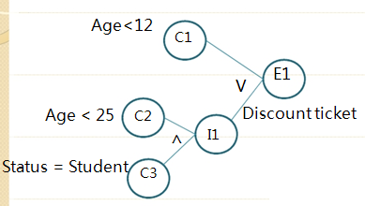
R
impossible combinations
 | 1 | 2 | 3 | 4 | 5 | 6 | 7 | 8
C1 | T | T | T | T | F | F | F | F
C2 | T | T | F | F | T | T | F | F
C3 | T | F | T | F | T | F | T | F
I1 | T | F | F | F | T | F | F | F
E1 | T | T | T | T | T | F | F | F
Limited decision table
How about using extended decision table?

Slide 14
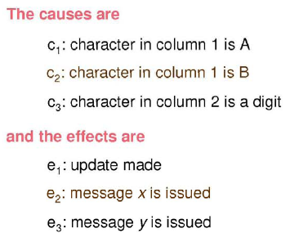
Example2
The character in column 1 must be an ‘A’ or ‘B’. The character in column 2 must be a digit. In this situation, the file update is made. If the character in column 1 is incorrect, message x is issued. If the character in column 2 is not a digit, message y is issued.

Slide 15
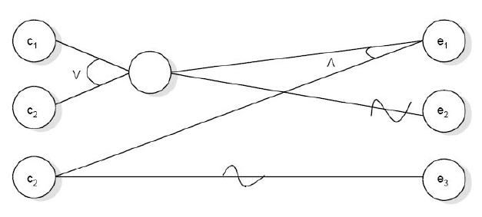
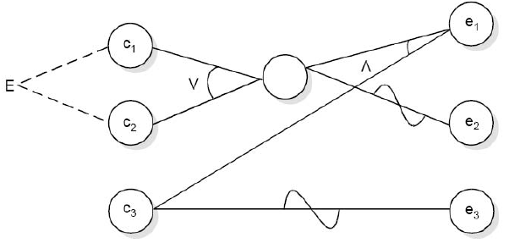
Change cause-effect graph to decision table.

Slide 16
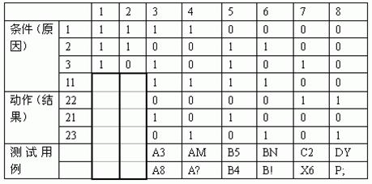

Slide 17
Example 3
Requirements for Calculating Car Insurance Premiums:
R00101 For males between 25 and 64 years of age, the premium is $1000
R00102 For males less than 25 years of age, the premium is $3000
R00103 For anyone 65 years of age or more, the premium is $1500
R00104 For females less than 65 years of age, the premium is $500

Slide 18
Causes (input conditions)
1. Sex is Male
2. Sex is Female
3. Age is <25
4. Age is >=25 and < 65
5. Age is >= 65
Effects (output conditions)
100. Premium is $1000
101. Premium is $3000
102. Premium is $1500
103. Premium is $500

Slide 19
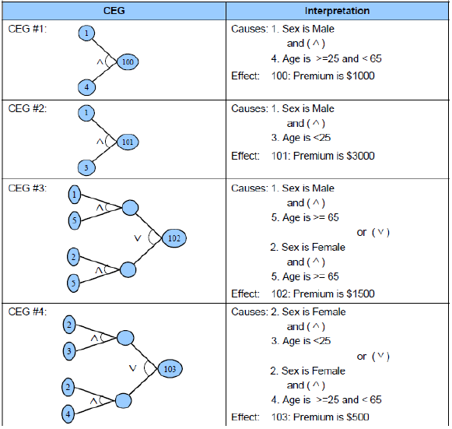
R00101 For males between 25 and 64 years of age, the premium is $1000
R00102 For males less than 25 years of age, the premium is $3000
R00103 For anyone 65 years of age or more, the premium is $1500
R00104 For females less than 65 years of age, the premium is $500

Slide 20
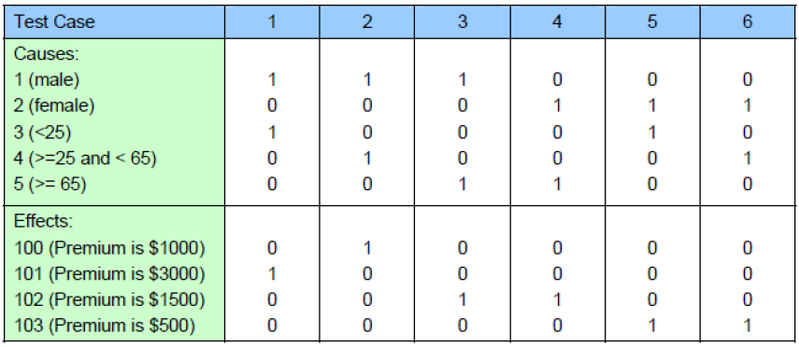
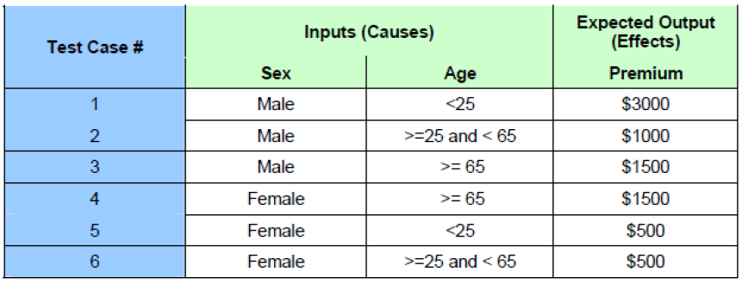

Slide 21
Exercise-1
Use extended decision table to test example 2.
The character in column 1 must be an ‘A’ or ‘B’. The character in column 2 must be a digit. In this situation, the file update is made. If the character in column 1 is incorrect, message x is issued. If the character in column 2 is not a digit, message y is issued.
Use extended decision table to test example 3.
Check out the number of rules.

Slide 22
Example 4
有一个处理单价为5角钱的饮料的自动售货机软件测试用例的设计。其规格说明如下：
若投入5角钱或1元钱的硬币，押下〖橙汁〗或〖啤酒〗的按钮，则相应的饮料就送出来。
若售货机没有零钱找，则一个显示〖零钱找完〗的红灯亮，这时在投入1元硬币并押下按钮后，饮料不送出来而且1元硬币也退出来；
若有零钱找，则显示〖零钱找完〗的红灯灭，在送出饮料的同时退还5角硬币。

Slide 23
1) 分析这一段说明，列出原因和结果
原因：
1.售货机有零钱找
2.投入1元硬币
3.投入5角硬币
4.押下橙汁按钮
5.押下啤酒按钮
结果：
21.售货机〖零钱找完〗灯亮
22.退还1元硬币
23.退还5角硬币
24.送出橙汁饮料
25.送出啤酒饮料

Slide 24
画出因果图，如图所示。所有原因结点列在左边，所有结果结点列在右边。建立中间结点，表示处理的中间状态。中间结点：
11. 投入1元硬币且押下饮料按钮 该找5角
12. 押下〖橙汁〗或〖啤酒〗的按钮 押下按钮
13. 应当找5角零钱并且售货机有零钱找 可找5角
14. 钱已付清 钱付清

Slide 25
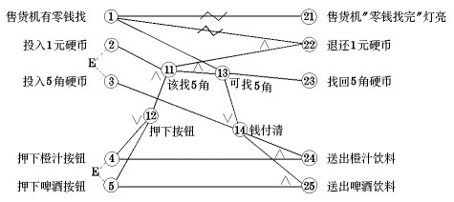

Slide 26
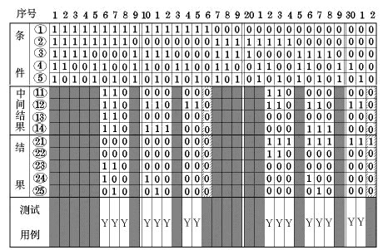
3)转换成判定表：

Slide 27
4) 在判定表中，阴影部分表示因违反约束条件的不可能出现的情况，删去。
第16列与第32列因什么动作也没做，也删去。最后可根据剩下的16列作为确定测试用例的依据。

Slide 28
Exercise-2
Other version of vending machine.
有一个处理单价为1元5角钱的盒装饮料的自动售货机。若投入1元5角硬币，按下“可乐”、“雪碧”或“红茶”按钮，相应的饮料就送出来。若投入的是2元硬币，在送出饮料的同时退还5角硬币。

Slide 29
因：
1、投入1元5角硬币
2、投入2元硬币
3、按下‘可乐’按钮
4、按下‘雪碧’按钮
5、按下‘红茶’按钮
果：
1、退出5角硬币
2、送出‘可乐’
3、送出‘雪碧’
4、送出‘红茶’

Slide 30
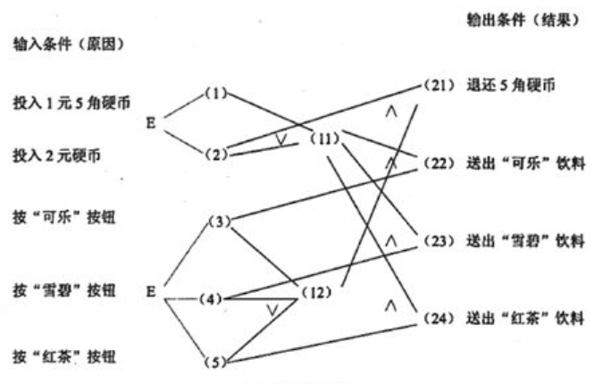

Slide 31
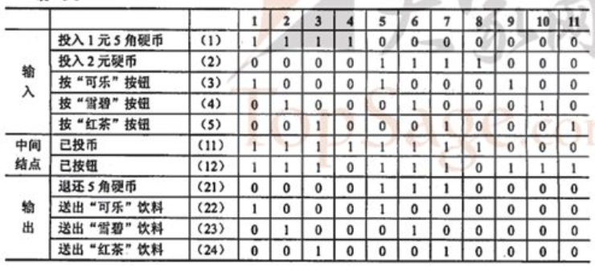

Slide 32
Exercise-3
Given the requirements as follows:
For international airlines of Europe and America, all classes have in-flight meals and in-flight entertainments;
For other international airlines, all classes have in-flight meals, only business classes have in-flight entertainments;
For domestic airlines, business classes have in-flight meals, but no in-flight entertainments;
For domestic airlines, economy classes have in-flight meals if the flying time is longer than 2 hours, but no in-flight entertainments.
Design the corresponding extended entry decision table:

Slide 33
Black Box Testing Techniques
• Boundary Value Analysis
• Equivalence Partitioning
• Decision Table
• Cause-Effect Graph
• Combinatorial Test

